Slide 1
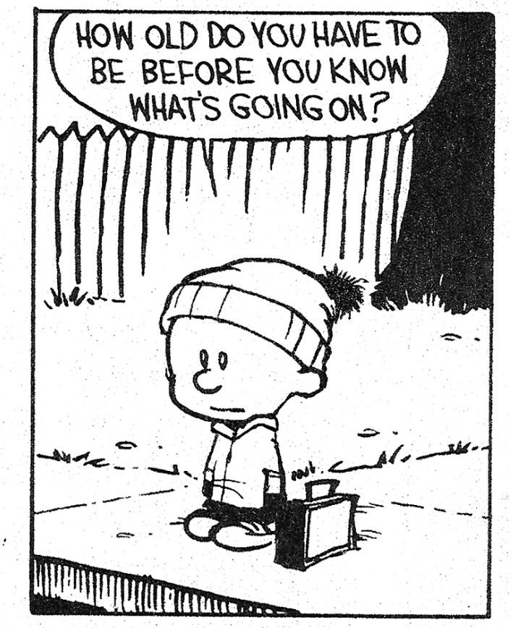

Developing Brains And Behaviour
Michaelmas Term 2024
Dr David Lawrence
David.lawrence@durham.ac.uk
@biojammer

Slide 2
Age of Criminal Responsibility
Current Minimum Age of Criminal Responsibility (MACR) in E&W is 10 years old
Children over ten should be subject to “the full brunt of the criminal law with no defence available to them to reflect their status as children”
  ﻿Elliott, ‘Criminal Responsibility and Children: A New Defence Required to Acknowledge the Absence of Capacity and Choice’ (2011) 75 Journal of Criminal Law 289, 289.
United Nations:
﻿“a minimum age of criminal responsibility below the age of 12 years is considered … not to be internationally acceptable”
﻿United Nations Committee on the Rights of the Child, ‘General Comment No. 10: Children’s rights in juvenile justice’ (2007) UN Doc CRC/C/GC/10, para 32.

Slide 3
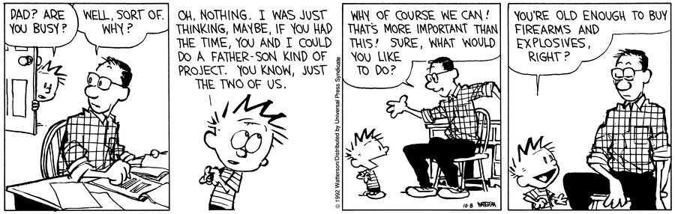
Context
<18s cannot:
  Vote, be a juror, buy alcohol, get a tattoo, buy fireworks, open bank account
<16s cannot:
  Leave school, buy lottery tickets, buy animals, consent to sex
>10s can:
  Be held to same criminal justice standards as an adult
Law Commission:
  if “a person cannot choose between right and wrong or … has no power to act on that knowledge, then it is not fair to hold that person criminally responsible”
    ﻿Law Commission, Murder, Manslaughter and Infanticide (Law Com No 304, 2006).
Neuroscience suggests that adolescents lack the capacity for fully rational decisions…

Slide 4
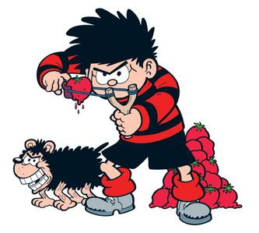
Criminal Responsibility in Children I
Role-based / Capacity-based / Practically-based understandings of responsibility
Criminal responsibility = Capacity/ Practical
Actus reus / mens rea
Capacity (here)= ability to understand right and wrong, consequences
Criminal responsibility = autonomous free choice of behaviour and capacity to make that choice
Ok it is really hard to find images relating to child criminal behaviour that aren’t depressing so work with me here

Slide 5
Criminal Responsibility in Children II
MACR dates from late 7th Century- children under 10 lack mens rea
  Laws of Ine, 694 CE
Bracton 13th Century- ﻿“harmlessness of intention”, “innocence of purpose”, “lack of intention to harm”
  ﻿Henry de Braction, ‘De Legibus et Consuetudinibus Angilae’ in George E Woodbine (ed), Thirteenth Century Law Tracts (Yale University Press 1910) 143-159.
Children Act 1908 recognized children not fully responsible for first time- MACR 7 years old
Children and Young Persons Act 1933 s.50 MACR 8 years old
Children and Young Persons Act 1963 Raised to 10 years old
Without MACR- how many of you were naughty toddlers?

Slide 6
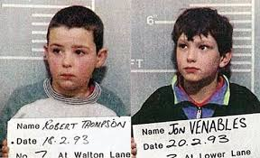
Criminal Responsibility in Children III- Doli incapax
Rebuttable presumption that 10-14 year olds are incapable of knowing right from wrong
Acted as a defence since 14th Century, established law 1845 (R v Smith)- requiring mens rea
Shift in attitude to defence following murder of Jamie Bulger 1993
“[doli incapax] is contrary to common sense … presuming that children of this age generally do not know the difference between naughtiness and serious wrongdoing”
Home Office, No More Excuses: A New Approach to Tackling Youth Crime in England and Wales (Cm 3809, 1997)
Defence abolished s.34 Crime and Disorder Act 1998

Slide 7
Current Position

Slide 8
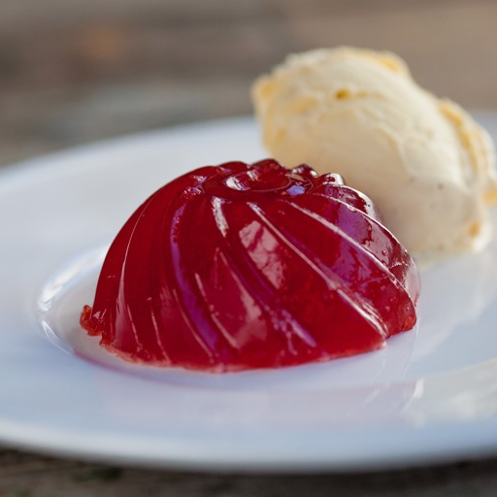
England and Wales
MACR 10 years old
﻿“… a person is completely irresponsible on the day before his tenth birthday and fully responsible as soon as the jelly and ice-cream have been cleared the following day”
  ﻿A T H Smith, ‘Doli Incapax under threat” (1994) 53 Cambridge Law Journal 426, 427.
Lowest MACR in Europe
UN has called for considerable raise

Slide 9
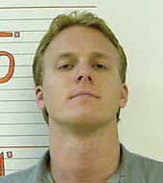
USA
Roper v Simmons 2005
  Capital punishment unconstitutional for under 18s
Relied on brain development neuroscience- more
immature, vulnerable, lack of control
Graham v Florida 2010 (non-homicide)- actions of child “not as morally reprehensible” as of adult / Miller v Alabama 2012 (homicide)
  Life without parole unconstitutional for adolescents
Increasing recognition of neuroevidence for criminal responsibility in children

Slide 10
Netherlands
Neuroevidence (medical/ physiological) comparatively widely used
Always accompanied by behavioural assessment to ensure reliability
MACR raised- justified by neuroscience:
  ﻿“risk behaviour occurs between the age of 15 and 23 and can also be attributed to an incomplete development of important brain functions. […] Modern research on the functioning of the brain aided by scanning techniques is said to explain that adolescents let themselves be guided more by brain parts reacting to immediate reward than adults” ﻿(Kamerstuk 33 498 Nr. 3 d. d. 13)
MACR 18, 18-23 at judge’s discretion

Slide 11
The Neuroscience Bit

Slide 12
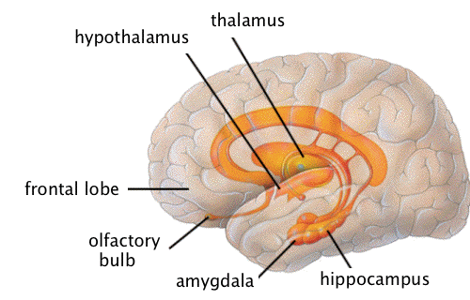
What should the MACR be?
Many facets of brain development influence behaviour
Development of amygdala- emotions, instincts etc- grows fast-
Growth of white and grey matter- transmission of brain signals- erratic signalling until properly distributed
Development of frontal lobe- rationality- grows slowly
Imbalance model of brain development- amygdala ahead of frontal lobe = impulse led behaviour
Executive function, judgement- matures in adulthood
Abstract thinking- guilt, awareness of consequences- in mid teens
By 10…?!?

Slide 13
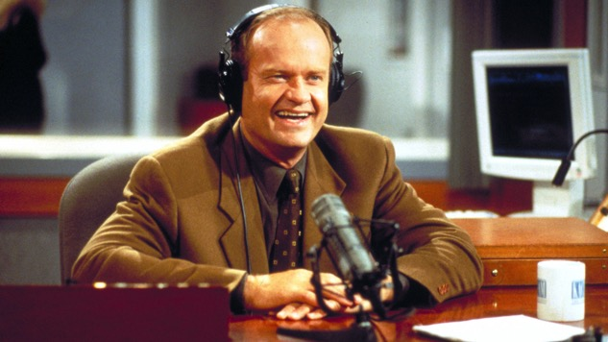
Social/ psychological evidence
US/ Netherlands- neuroevidence often accompanied with supporting evidence for reliability- model for EW?
Psychological development of different characteristics occurs at different rates- intellectual, emotional, moral…
Cognitive structure- experiential filters
Jean Piaget- capacity for formal reason begins around 11 years old
So- does one standard MACR even make any sense?
Yeah, I know he’s a psychiatrist, but you try finding a fun picture of a psychologist.

Slide 14

Agency and Responsibility
Individual’s capacity to act on intentions
”my” actions
Whether we have free will or not (next week!), actus reus only requires the impression that you could act otherwise
Children seen as unable to exercise rational behavioural control

Slide 15
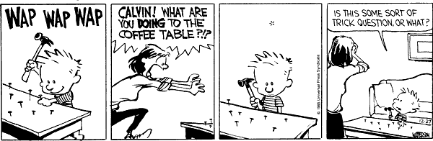
Should we use this neuroevidence?
Children can’t rationally control their behaviour
Criminal justice system ignores developmental maturity
Criminal liability “should be imposed only on persons who are sufficiently aware of what they are doing, and of the consequences it may have, that they can fairly be said to have chosen the behaviour and its consequences”
  (Ashworth, 2003: 158)
R v G and R 2003- ‘ignoring the special position of children… is not acceptable in a modern civil society’

Slide 16

Limitations
Association ≠ causation
We understand so little about the brain and brain development! Accuracy, validity of evidence…
‘ecological validity’ – is your brain like my brain? Is the lab brain like your brain?
Differing rates of development between individuals
Oversimplification of science, overreach of scientific testimony, influencing/ replacing juries
Historical limits- trials taking place well after crimes- brain changes
Do these lend any weight to calls for cognitive rights?

Slide 17
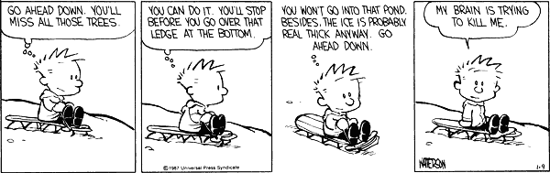
Reforms?
Raise the MACR?
Suggestions of 14 or 15 for a practical compromise
Is a new defence necessary between 15-21?
Requirement to prove defendant probably knew conduct was wrong?
Neuroevidence to support underdevelopment?
Something needs to change- we cannot blame people for that which they could not control!

Slide 18
Developing Brains And Behaviour
Questions for Reflection
Does having a set MACR make sense?
How much latitude can the law afford to give?
Can scientific fact excuse the worst behaviours?

